Slide 1



NFC SOUTH DATABASE
Tri Nguyen, Kevin vo, Quoc Than, Benjamin Leung

Slide 2

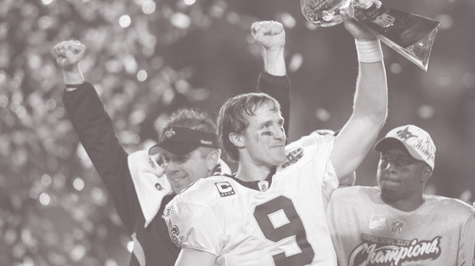

MOTIVATION
NFC South is a division within NFL
NFC South because our favorite team Saints are in that division
NFL is a good database because there are plenty of data you can look for like stats or even information for each player.
NFL has many games on the weekends and its hard to keep track of stats in a game.

Slide 3


OUR PROJECT
Compile data from online resources for NFC South football teams
Organize data into a working database
Derive statistics not commonly found on current, popular resources
Use data to analyze team performance by comparison
References:
https://www.footballdb.com/
http://www.nfl.com/stats/player

Slide 4
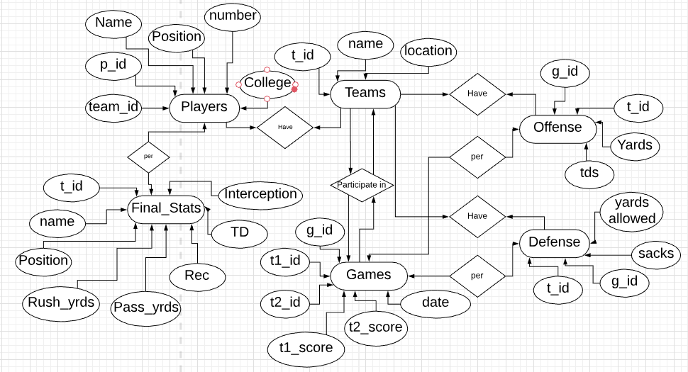
E-R DIAGRAM

Slide 5
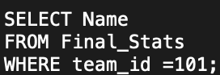
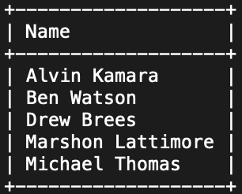
DATABASE DEMO
Show all Saints players from the Final Stats
SQL Skill:
SELECT
FROM
WHERE

Slide 6
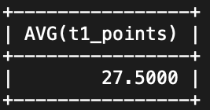
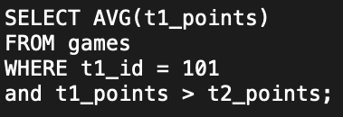
DATABASE DEMO
Show the average number of touchdowns from the Saints
SQL Skill: Aggregate Functions (AVG) Average

Slide 7
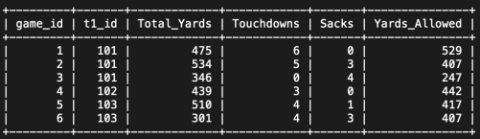
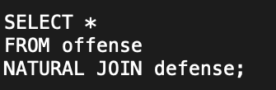
DATABASE DEMO
Combine offense and defense stats for each game
SQL skill: Natural Join

Slide 8
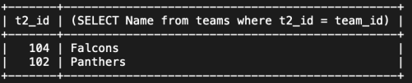
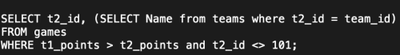
DATABASE DEMO
If the Saints played against the Buccaneers, who did they beat based off the data sets?
This finds the team ids of the teams that the Saints defeated by using subquery into the other data sets
SQL skill: Subqueries

Slide 9
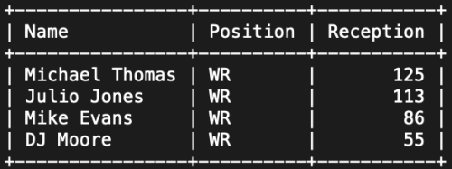
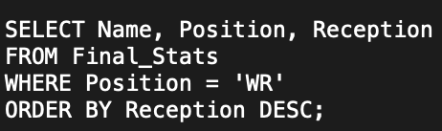
DATABASE DEMO
Organized Reception from greatest to least for WR
SQL Skill: ORDER BY, DESC

Slide 10
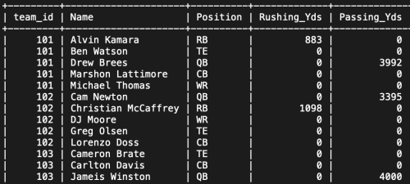
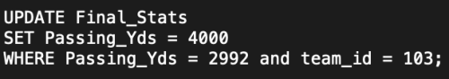
DATABASE DEMO
We wanted to update the 2992 passing yards to 4000 passing yards
SQL Skill: Update

Slide 11
WHAT DID WE LEARN?
We learned how to collect data from resources and use that data to create a database.
How to use SQL queries to pull data from those tables and manipulate the data.
We learned the importance of database set keys that help create relations between the data sets.

